Slide 1
Kaggle Intro to Machine Learning

Slide 2
Lesson 1: How Models Work
The step of capturing patterns from data is called fitting or training the model.
The data used to fit the model is called the training data.
After the model has been fit, you can apply it to new data to predict prices of additional homes.
One type of model is - Decision Tree.
In decision tree, you can capture more factors using a tree that has more "splits." These are called "deeper" trees.

Slide 3
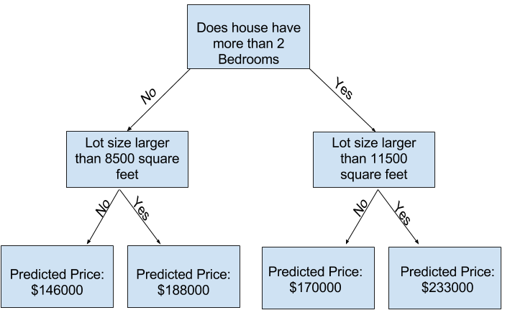
You predict the price of any house by tracing through the decision tree, always picking the path corresponding to that house's characteristics.
The predicted price for the house is at the bottom of the tree.
The point at the bottom where we make a prediction is called a leaf.

Slide 4
Lesson 2 : Basic Data Exploration
Using Pandas to Get Familiar With Your Data
Pandas is the primary tool data scientists use for exploring and manipulating data.
Most people abbreviate pandas in their code as pd.
We do this with the command.
import pandas as pd

Slide 5
The most important part of the Pandas library is the DataFrame.
A DataFrame holds the type of data you might think of as a table. This is similar to a sheet in Excel, or a table in a SQL database.
# save filepath to variable for easier access
melbourne_file_path = '../input/melbourne-housing-snapshot/melb_data.csv’
# read the data and store data in DataFrame titled melbourne_data
melbourne_data = pd.read_csv(melbourne_file_path)
# print a summary of the data in Melbourne data
melbourne_data.describe()

